Slide 1
Cultural Marxism and the New Left
Big Sky Worldview Forum
Glenn Sunshine
www.esquareinch.org

Slide 2
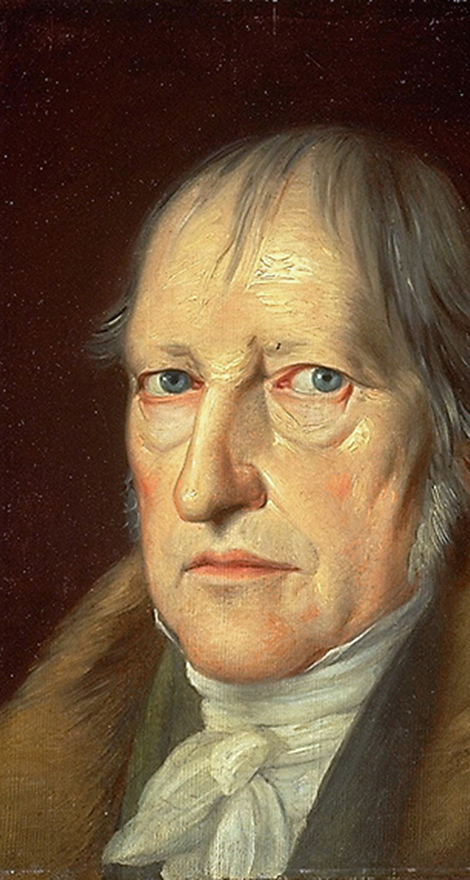
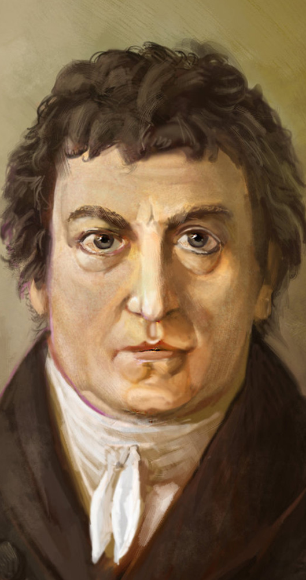
Georg Friedrich Wilhelm Hegel (1770-1831)
The Process of History
Reason and Freedom
Geist
Prussia
Johan Gottlieb Fichte (1762-1814)
Thesis-Antithesis-Synthesis
“Hegelian Dialectic”

Slide 3
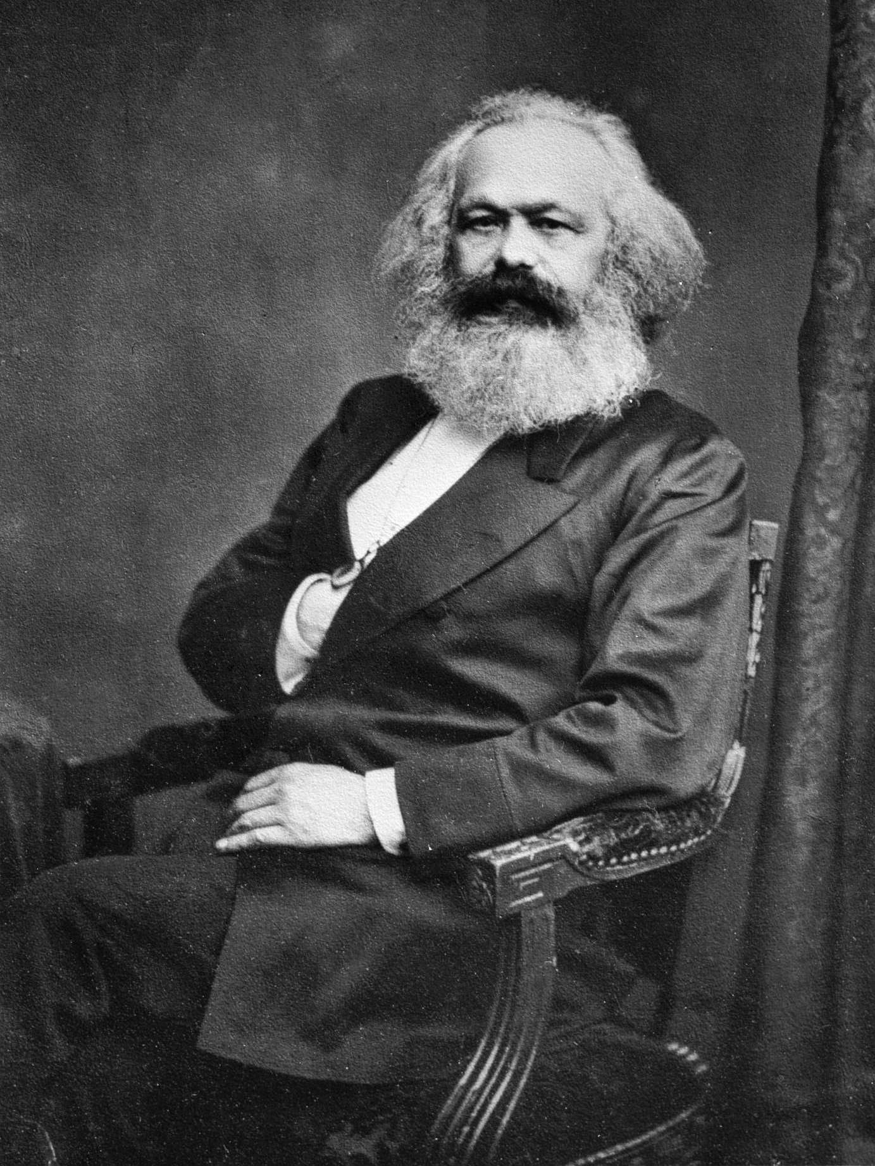
Karl Marx (1818-1883)
Young Hegelians
Accept Dialectic of History
Reject Prussia as End of History
Strategy: Attack Christianity to Undermine Prussia
Marx Breaks with Young Hegelians
Capital (Surplus Wealth) as Basis of Society
Culture and Religion as Epiphenomena of Economic System
“Dialectical Materialism”

Slide 4
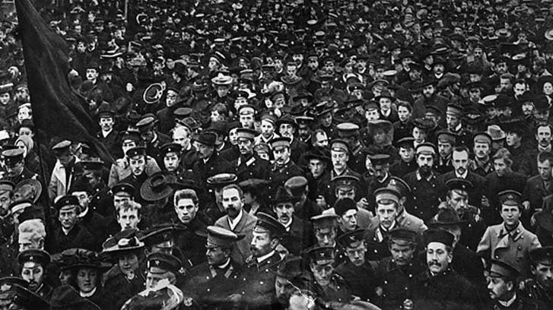
Classical Marxism
Secular Myth
Self-Created Universe
Evolution
The Problem
Economic Oppression
Class = Identity
The Inevitable Solution
Proletariat Revolution
Classless Society
Marxist-Leninism
Maoism

Slide 5
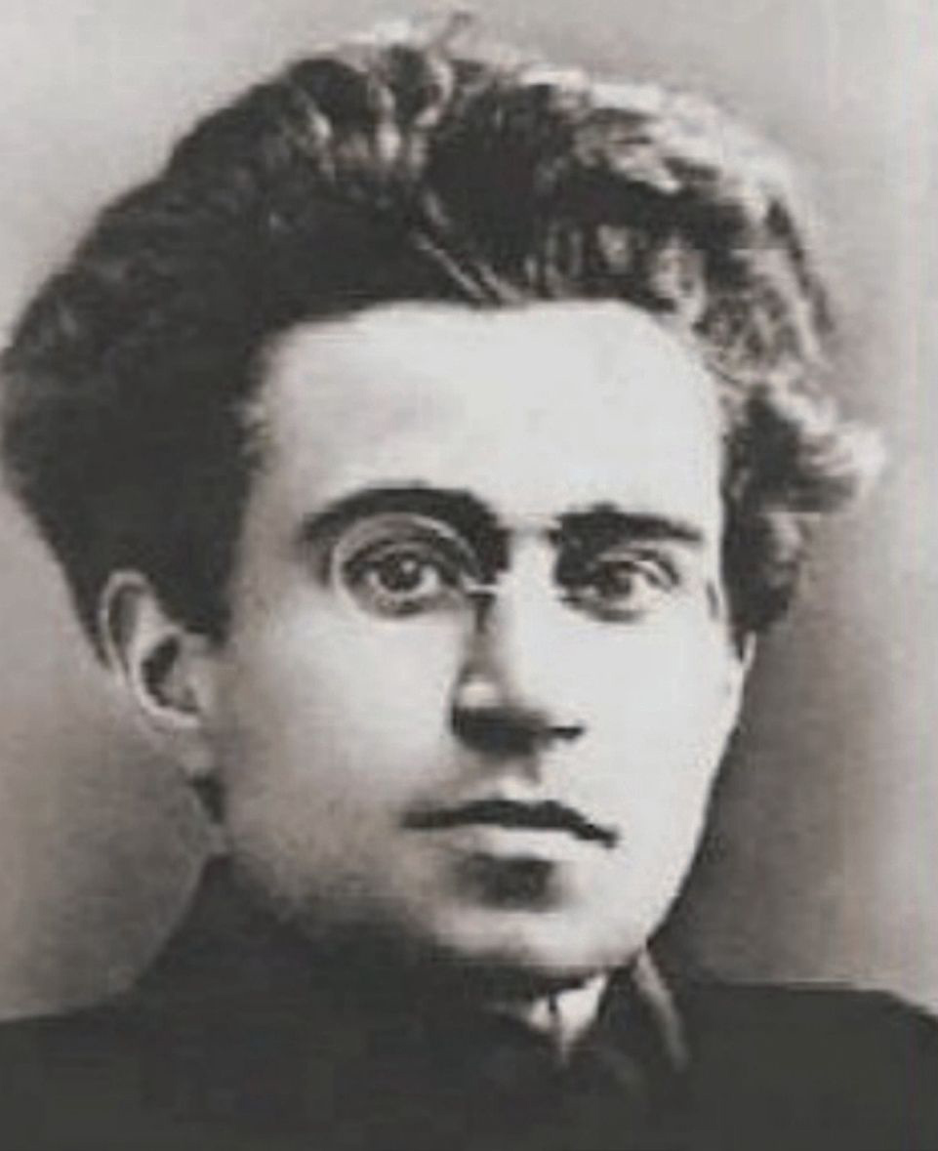
Antonio Gramsci (1891-1937)
Why did Marxism fail?
Cultural Hegemony
Ideology, not Economy
Role of Institutions
Counter Hegemony
Union of Intellectuals and Workers
New Ideology
Infiltrate Institutions

Slide 6
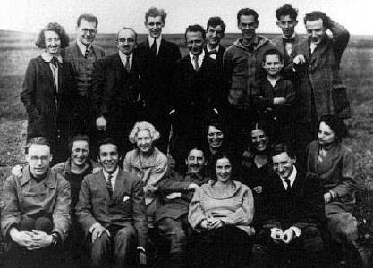
The Institute for Social Research/Frankfurt School
Founder Carl Grünberg (1923)
To Geneva (1933)
New York (1935): Columbia University
Influences
Immanuel Kant
Georg Friedrich Hegel
Karl Marx
Sigmund Freud

Slide 7
The New Left
False Consciousness
Following the Cultural Hegemony
Raising Consciousness
Awareness of Oppression
Class Consciousness
Group Identity/Identity Politics

Slide 8
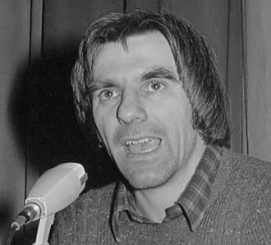
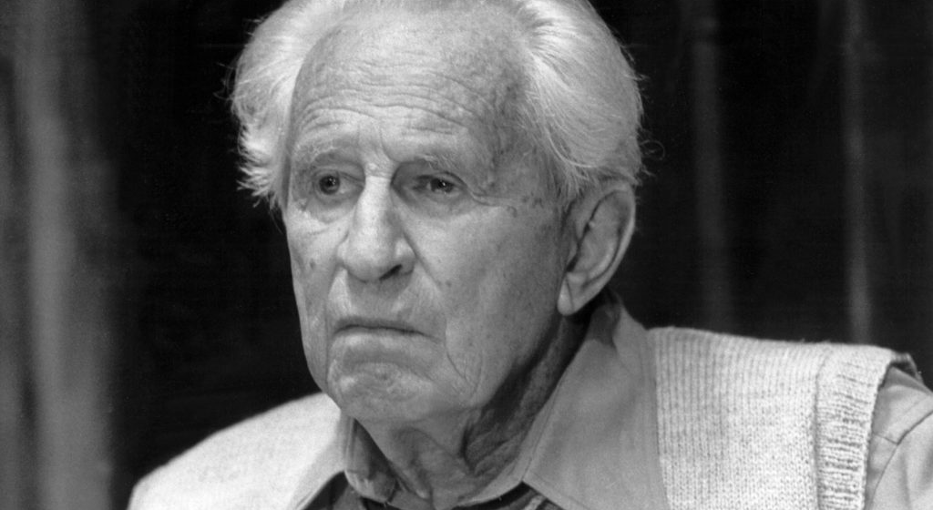
The Long March through the Institutions
Rudi Dutschke (1967)
Herbert Marcuse, Counterrevolution and Revolt (1972)
Popularized Term and Strategy
Focus on Media

Slide 9
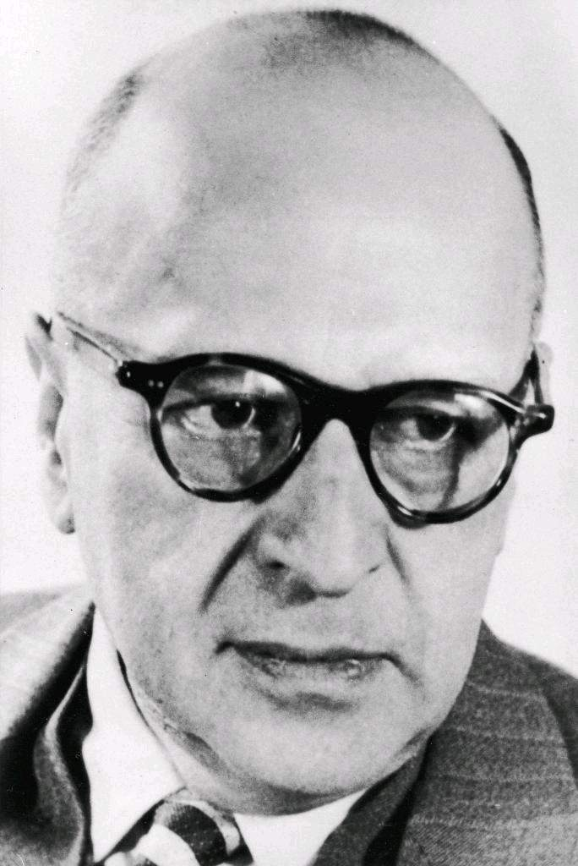
The Long March through the Institutions
“The revolution won't happen with guns, rather it will happen incrementally, year by year, generation by generation. We will gradually infiltrate their educational institutions and their political offices, transforming them slowly into Marxist entities as we move towards universal egalitarianism.” –Max Horkheimer

Slide 10
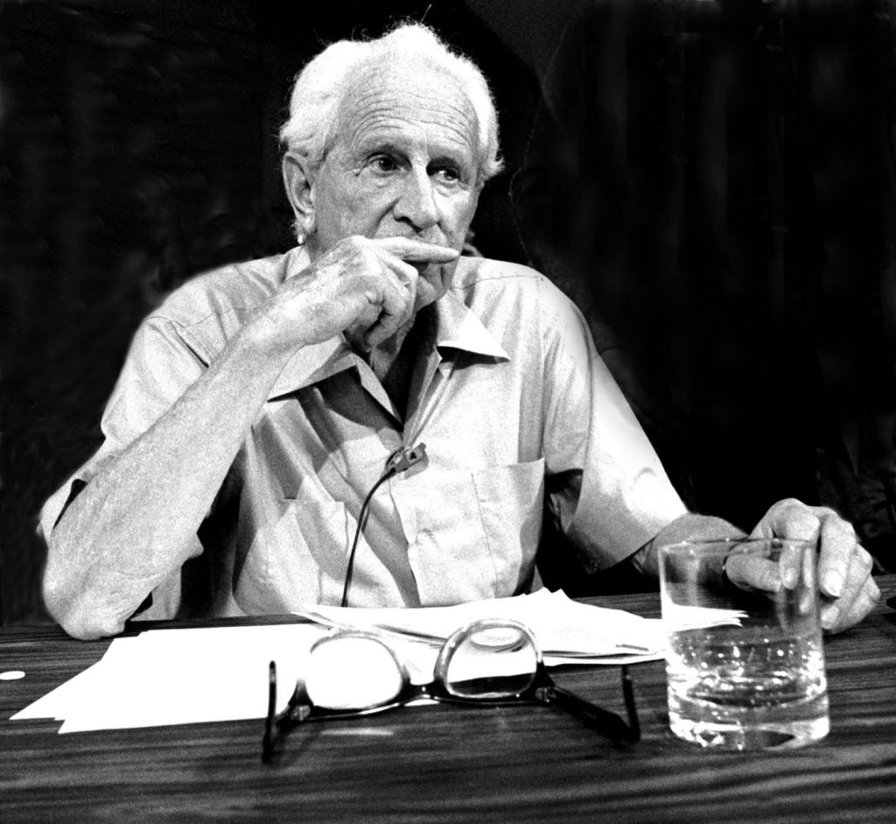
Repressive Tolerance (Herbert Marcuse)
Tolerance of Left, Not Right
Education
Indoctrination
Violence

Slide 11
Repressive Tolerance (Herbert Marcuse)
They would include the withdrawal of toleration of speech and assembly from groups and movements which promote aggressive policies, armament, chauvinism, discrimination on the grounds of race and religion, or which oppose the extension of public services, social security, medical care, etc. Moreover, the restoration of freedom of thought may necessitate new and rigid restrictions on teachings and practices in the educational institutions which, by their very methods and concepts, serve to enclose the mind within the established universe of discourse and behavior — thereby precluding a priori a rational evaluation of the alternatives. And to the degree to which freedom of thought involves the struggle against inhumanity, restoration of such freedom would also imply intolerance toward scientific research in the interest of deadly “deterrents,” of abnormal human endurance under inhuman conditions, etc.

Slide 12
Summary: Cultural Marxism
Any Worldview that Divides World into Heroes and Villains Derives from Marx (and Ultimately Hegel)
Classical Marxism Focuses on Economic Classes
Cultural Marxism Focuses on Cultural “Hegemony” and Worldview
Raise Awareness of “Oppression”
Oddly, Not Including the Poor
Group Identity
Unite the Oppressed against the Hegemony
Strategy
Control Levers of Culture
Suppress Dissent

